Slide 1
Sentence Structure
Chapter 10

Slide 2
Sentences
We just finished word processing – what happens when you string them together?

Slide 3
Sentences
Thematic roles – who is doing what to whom
Goal of sentences is to put things into roles
Verb argument structure – set of possible themes associated with a verb

Slide 4
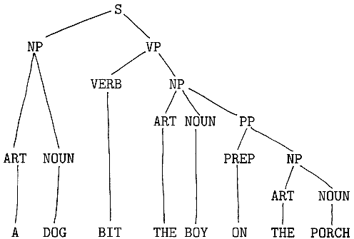
Sentences

Slide 5
Sentences
Parsing – analyzing grammatical structure of a sentence to assign thematic roles

Slide 6
Sentences
Parsing Parts
Figure out each words part (noun, verb)
Break into phrases
Find the subject
Word order!

Slide 7
Sentences
Model types
Autonomous models – syntax can only influence syntactic representation, separated from semantics
Interactive models – both syntax and semantics can influence the syntactic processors

Slide 8
Sentences
Model types
One stage models – both syntactic and semantic information are use to construct the model in one go
Two stage models – syntax is processed first, then semantics

Slide 9
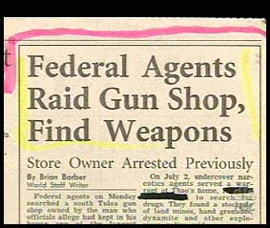
Ambiguity
Police Seek Orange Attackers
Enraged Cow Injures Farmer With Axe
http://www.fun-with-words.com/
ambiguous_headlines.html

Slide 10
Ambiguity
Why study ambiguity?
It’s a strain on your processing system, so it helps us understand processing
Especially since you can study this with eye tracking

Slide 11
Ambiguity
Models (combinations of the ones listed earlier)
Serial autonomous model – create a parse tree with syntax only
If it breaks, you go back and recreate the tree

Slide 12
Ambiguity
Models
Parallel autonomous model – creating all syntactic representations possible
Chose the one that makes the most sense

Slide 13
Ambiguity
Models
Interactive models – using semantics along with syntax to create the most plausible model

Slide 14
Ambiguity
How do we tell which model is correct?
Garden path sentences – sentences that lead you astray in processing so that you have to go back and reprocess
Participles – type of verbal phrase where the verb is turned into an adjective by adding ed or ing

Slide 15
Ambiguity
Garden Paths
The old man the boats.
The horse raced past the barn fell.

Slide 16
Ambiguity
Garden Paths
Reduced relative – a relative clause that has been reduced by removing the relative pronoun and “was”
Complimentizer – a category of words (that) used to introduce a subordinate clause.

Slide 17
Ambiguity
Garden Paths
The horse, that was raced past the barn, fell.

Slide 18
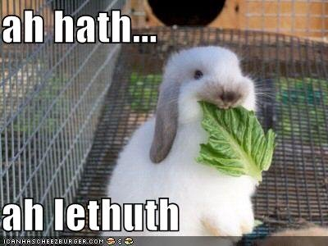
Ambiguity
Garden Paths
Things that help: commas, normal speech pauses
Most people consider these reduced clauses implausible, they don’t occur normally.

Slide 19
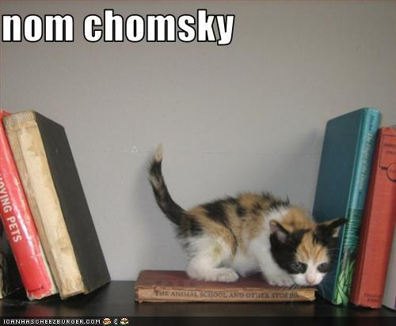
Early Parsing
Chomsky

Slide 20
Early Parsing
Chomsky
Generative grammar – understanding sentences involves pulling up their deep structure

Slide 21
Early Parsing
Derivational theory of complexity – the more complex the syntax, the more transformations you will need to get to deep structure.
Should take you longer to process
Autonomy of syntax – syntax and semantic processing are separate things

Slide 22
Early Parsing
Transformations
Obligatory – transformations that are required for the sentence to be grammatical. Verb subject matching.
Optional – Things that are not required – for example, making things passive voice.

Slide 23
Early Parsing
Kernel sentences – active, affirmative, declarative forms of English, where obligatory transformations have occurred.
Some research supports that transformation sentences take you longer to process

Slide 24
Early Parsing
Problems with transformational grammar:
Of course these sentences take longer, they are more complex and have more words
Reversible versus irreversible passives?

Slide 25
Early Parsing
Reversible versus irreversible passives?
Reversible: The ghost was chased by the robot / the robot was chased by the ghost.
Irreversible: The flowers were watered by the robot / the robot was watered by the flowers.

Slide 26
Early Parsing
Reversible versus irreversible passives?
Take longer on reversible sentences because you are transforming it
Irreversible sentences do not show effect because it’s deemed implausible
Autonomy syntax = broken
Shouldn’t see this.

Slide 27
Later Parsing
Syntax proposes, semantics disposes
Build parse tree based on syntax, go back when semantics doesn’t make sense.

Slide 28
Later Parsing
Parsing unit size:
Sentences are major processing unit
Forget actual words after sentence boundary
Clauses are important
Clauses are group of related words containing a subject and verb

Slide 29
Later Parsing
Parsing unit size:
Clause boundary effect – words are best remembered from the current clause
Eye fixations are longest at the end of each clause

Slide 30

Later Parsing
Click experiments
Left ear: sentences
Right ear: clicks
Clicks were in the middle of the clause.
Where did they report hearing them?
At the end of the clause.

Slide 31
Later Parsing
Click experiments
Another experiment didn’t actually play clicks
Subliminal perception – or so they thought
Where do you think they reported the “clicks”?

Slide 32
Later Parsing
Parsing unit size:
Some word interaction instead of just clauses
Word generation: if you give this:
Christina thought the book was boring. He was sure to return it to the library.
People get big spikes at HE since it doesn’t match.

Slide 33
Later Parsing
Parsing unit size:
Some word interaction instead of just clauses
Eye tracking show word effects:
The woman will spread the butter (look at the bread)
The woman will slide the butter (look at the man in the scene)

Slide 34
Parsing Processes
Kimball’s 7 Principles of Parsing
Use surface structure to uncover syntactic structure
These processes help memory load

Slide 35
Parsing Processes
Kimball’s 7 Principles of Parsing
Parsing is top down – we start at the beginning of the sentence and look one or two words ahead and predict constituents

Slide 36
Parsing Processes
Kimball’s 7 Principles of Parsing
Right association – the new words are attached to the lowest structure build so far
New nodes - function words signal a new phrase

Slide 37
Parsing Processes
Kimball’s 7 Principles of Parsing
Processing limits – can only cope with two sentence nodes (embedded clauses are hard)
Closure – prefer to close a phrase structure as soon as possible

Slide 38
Parsing Processes
Kimball’s 7 Principles of Parsing
Fixed structure – do not want to go back and restructure a clause
Processing - when you close a phrase it goes from short term memory to semantic processing

Slide 39
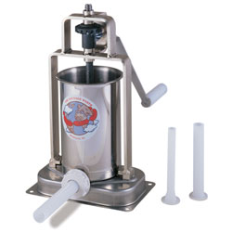
Parsing Processes
Kimball’s “Sausage Machine”
Preliminary phrase packager – seeing about 6 words ahead, using rules to create phrases
Sentence structure supervisor
Constructs the phrases

Slide 40
Structural Ambiguity Models
Garden path – autonomous two stage model
First stage: syntax
Ambiguity: one representation is built
Late closure – incoming material should be added to the current phrase
Minimal attachment – incoming material is attached with the fewest nodes

Slide 41
Structural Ambiguity Models
Garden path – autonomous two stage model
Second stage: thematic semantic information
Might go back to stage one, if the second stage does not work

Slide 42
Structural Ambiguity Models
Constraint based models – Interactive one stage model
Use multiple constraints from semantics, thematic, discourse, and syntax to create parse tree.

Slide 43
Structural Ambiguity Models
Evidence for autonomy
Since Jay always jogs a mile and a half this seems a very short distance to him. (late closure)
Since Jay always jogs a mile and a half seems a very short distance to him. (not late closure but we try)
The criminal confessed his sins harmed many people (minimal attachment).

Slide 44
Structural Ambiguity Models
Evidence for autonomy – semantic information does not help with garden path (so no interaction)
The defendant examined by the lawyer turned out to be unreliable
The evidence examined … same sentence.

Slide 45
Structural Ambiguity Models
Evidence for autonomy – brains
Can damage semantics and syntax separately
N400 lexical access/semantics
P600 syntax

Slide 46
Structural Ambiguity Models
Evidence for autonomy – brains
Boris noticed the puncture and got out to change the wheel on the castle. (N400!)
Boris persuaded to fly. (P600!)

Slide 47
Structural Ambiguity Models
Evidence for autonomy – brains
The cats won’t bake the food that Mary leaves them (semantic)
The cats won’t eating the food that Mary leaves them (syntactic)
The cats won’t baking the food that Mary leaves them (both).

Slide 48
Structural Ambiguity Models
Evidence for autonomy – brains
Representational modularity – semantic and syntactic information are represented separately
Processing modularity – do they work together or separately or is information restricted?

Slide 49
Structural Ambiguity Models
Evidence for interaction
Semantic bias – when the sentence biases the phrase structure to create non-minimal attachment rules

Slide 50
Structural Ambiguity Models
Evidence for interaction
Semantic violations = garden path:
The granite rocks during the earthquake
The table rocks during the earthquake

Slide 51
Structural Ambiguity Models
Evidence for interaction
Referential theory - Generally it is thought that we create the phrase structure tree word by word with a strongest one as the best. All others are generated but ruled out (or weaker) by context.

Slide 52
Structural Ambiguity Models
Evidence for interaction
The vampires loaned money at low interest were told to record their expenses.
Only vampires loaned money at low interest were told to record their expenses.
The ONLY helps us avoid the garden path.

Slide 53
Structural Ambiguity Models
Evidence for interaction
Verb bias – the frequency of verb interpretation
Direct object verbs – most frequent continuation is a direct object (gave)
Sentence complement verbs – common continuation is sentence complement (realize)

Slide 54
Structural Ambiguity Models
Evidence for interaction
Competition integration model – checks the interpretation after each new word.
Digging in – if the ambiguity lies farther away then we have decided on one model and don’t want to give it up
After the Martians invaded the town that the city bordered…was evacuated.

Slide 55
Structural Ambiguity Models
Evidence for interaction – brains
Ambiguity – more brain activation
Brocas: syntactic representation
Wernickes: semantic representation

Slide 56
Models?
So which is it?

